Slide 1
Parallel I/O Optimizations for Scalable Deep Learning
Sarunya Pumma (sarunya@vt.edu), Min Si, Wu-chun Feng, and Pavan Balaji
12/16/2017

Slide 2
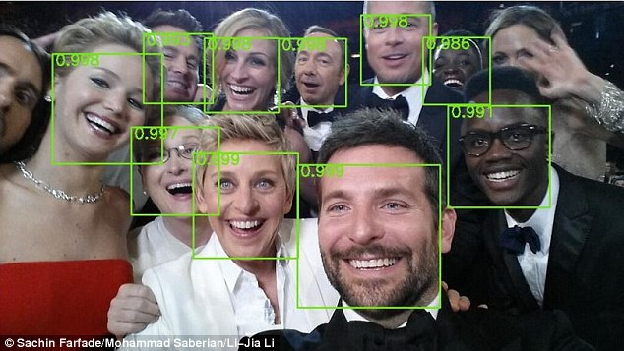

Offline & Online Data Analytics
Real Time News Feed (Facebook)
Speech Recognition
DeepSpeech (Baidu)
Artificial Intelligence Software
AlphaGo (Google DeepMind)
Robotics
Asimo (Honda)
Facial Recognition
Deep Dense Face Detector (Yahoo Labs)
Navigation Engine
Autopilot (Tesla)
Machine Learning
Notes:
Lee Sedol

Slide 3
Deep Learning Scaling
Dataset: CIFAR10-Large Network: AlexNet
Batch size: 4,096 Training iterations: 1,024
Testbed: LCRC Blues (Each node: 16 cores Intel Pentium Xeon processors, 64 GB memory)
Training Time
Execution Time Breakdown
Caffe is 20x worse than ideal
for 512 processes

Slide 4
Our Solution: LMDBIO
An optimized I/O subsystem for scalable deep learning
Extended from LMDB (Lightning Memory-Mapped Database)
Provides highly efficient parallel data reading capability
Our previous work: LMDBIO-LMM
Solves interprocess contention caused by mmap within a node
Limited to intranode I/O performance
We proposed LMDBIO-DM
Continues to improve LMDB on in distributed-memory environment
Tackles redundant database access of LMDB due to sequential data access restriction
Notes:
1. Interprocess contention
Caused by mmap which is used internally in LMDB
Caused

Slide 5
Analysis of LMDB

Slide 6
Overview of Caffe and Its Parallel Data Reading
Caffe is a well-known Convolutional Neural Network (CNN) training framework
Lightning Memory-Mapped Database (LMDB) is a default database engine of Caffe
It is used commonly by deep learning frameworks (e.g., TensorFlow, Torch, Keras)
Every process reads a database concurrently without any cooperation
Machine 1
Machine 2
DB
DB
DB
DB
DB
DB
P0
P1
P2
P3
P4
P5
Example of data batch loading on 2 machines

Slide 7
Analysis of LMDB’s Data Structure
LMDB database’s structure is a flattened B+ tree
Highly efficient for sequential database accesses
B+ tree structure
Branch nodes
Leaf nodes (key & value)
Database layout
Divided into small pages
4 types of pages
Metadata page – database’s info (e.g. size)
Branch page – links to leave pages
Leaf page – stores key & value
Overflow page – stores the value that is larger than one page
Each page has a header that contains the pointer information of connected pages
Every page except for some overflow pages has a header
Only the first overflow page has a header
Branch node
3 |  | 5
d_{i} = i^{th} data record
1 |  | 2 |  | 3
d₁ | d₂ |  | d₃
4 |  | 5
d₄ | d₅
6 |  | 7
d₆ | d₇
Leaf node l₁
Leaf node l₂
Leaf node l₃

Slide 8
Analysis of Redundant Data Movement
LMDB data access is sequential in nature due to the B+-tree structure (which is not deterministic)
It is impossible to randomly access a data record without sequential record seeking
All branch nodes associated with the previous records are read
Heavy I/O occurs to load pages from the file to get connection information
When multiple processes read the data, they read extra data
The worst case is to read (# of readers) x (read size) bytes
Different processes do different amount of work, causing skew
Database
D0 | D1 | D2 | D3
P0 reads
P1 seeks
P1 reads
P2 seeks
P2 reads
P3 seeks
P3 reads

Slide 9
LMDBIO-DM Design and Implementation

Slide 10
LMDBIO-DM: Design and Implementation Part I
Part I: Serializing I/O & process coordination
Each process reads its data and sends the higher rank process the location to start fetching its data from
Number of bytes read is EXACT… but I/O is done sequentially
We use symmetric memory allocation technique to allow processes to exchange the complex data structure that represents the position of a data record in the B+ tree, called “cursor”
Cursor contains addresses of branch nodes and a leave node
Database
D0 | D1 | D2 | D3
P0 reads
P0 sends cursor to P1
Sequential
P1 reads
P1 sends cursor to P2
P2 reads
P2 sends cursor to P3
P3 reads
…

Slide 11
LMDBIO-DM: Design and Implementation Part II
Part II: Speculative data reading
Each process estimates and prefetches some data before preforming in-memory data seek
The estimation is corrected in every iteration by using the actual data read in all of the previous iterations
This add a small amount of extra data reading, but allows parallel I/O
Database
D0 | D1 | D2 | D3
Concurrent speculative read
P0 reads
P1 reads
P2 reads
P3 reads
P0 seeks
P0 sends cursor to P1
Sequential
In-memory seek
P0 accesses
P1 seeks
P1 sends cursor to P2
Timeline
P1 accesses
P2 seeks
P2 sends cursor to P3
P2 accesses
P3 seeks
P3 sends cursor to P0
(for the next batch)
P3 accesses

Slide 12
Experiments and Results

Slide 13
CIFAR10-Large Results
Dataset: CIFAR10-Large Network: AlexNet
Batch size: 4,096 Training iterations: 1,024
Testbed: LCRC Blues (Each node: 16 cores Intel Pentium Xeon processors, 64 GB memory)
Training Time
Execution Time Breakdown
Notes:
16 GB

Slide 14
ImageNet Results
Dataset: ImageNet Network: CaffeNet
Batch size: 4,096 Training iterations: 32
Testbed: LCRC Blues (Each node: 16 cores Intel Pentium Xeon processors, 64 GB memory)
Training Time
Execution Time Breakdown
Notes:
24 GB

Slide 15
Conclusion
I/O is a significant problem in deep Learning
Improved hardware trends making communication and computation faster, making I/O an even bigger problem
We proposed LMDBIO: an optimized I/O framework specially designed for deep-learning applications
LMDBIO with both optimizations significantly improves deep learning performance
For CIFAR 10-Large, we achieve nearly 5x improvement
For ImageNet-Large, we achieve nearly 53x improvement

Slide 16
Thank you

Slide 17
Back Up Slides

Slide 18
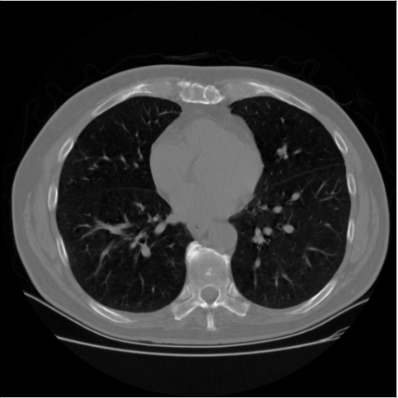
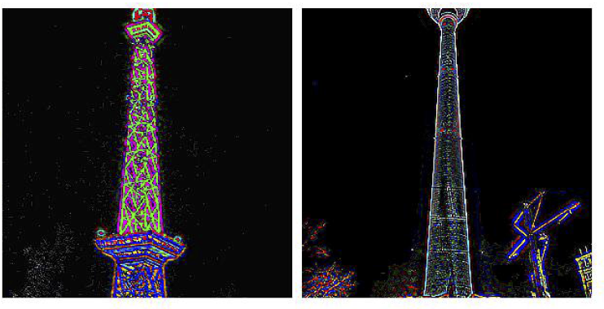
Deep Learning Challenges
Compute bound
In the past decade …
10 – 20x improvement in processor speed
10 – 20x improvement in network speed
Only 1.5x improvement in I/O performance
I/O will eventually become a bottleneck for most computations
High-dimensional input data
Image classification
Data Science Bowl’s tumor detection from CT scans
I/O Bound
High volume data
Sentiment analysis
Twitter analysis
Yelp’s review fraud detection
Image classification
ImageNet’s image classification
Batch Size
(# samples)
Tumor detection from CT scans
Communication bound
Networks with large number of parameters
Unsupervised image feature extraction
LLNL’s network with 15 billion parameters
Network Size
(width and depth)
Image feature extraction

Slide 19
LMDBIO-LMM: Overview
Problem
High interprocess contention due to mmap’s way of handling I/O
Solution
Localized mmap
Only one process does mmap on each node
Using MPI shared-memory (MPI-3) to share data
LMDBIO has extra copy (copying from mmap to shared memory)
Caffe still gains benefit from LMDBIO
Process 0
Process 1
Process 2
Copy
Access
Access
Access
mmap buffer
(Process 0)
Shared Memory
Map
Page cache
Read
Shared file system
(shared between nodes)
Sarunya Pumma, Min Si, Wu-chun Feng and Pavan Balaji. Towards Scalable Deeplearning via I/O Analysis and Optimization. IEEE International Conference on High Performance Computing and Communications (HPCC). Bangkok, Thailand, Dec 18 – 20, 2017.

Slide 20
LMDBIO-LMM: Performance Analysis
Training Time
Execution Time Breakdown
We still have more room to improve read time
Skew time is very large due to I/O imbalance

Slide 21
LMDBIO-DM: Process Coordination
The data structure, called “cursor”, is need in order to get the data
Cursor contains addresses of branch nodes and a leave node
To exchange the cursor between nodes, we use symmetric memory allocation
Using mmap’s fixed address to allocate an identical virtual address space on each node
A reader serializes a cursor and sends it to another process
Another process deserializes a cursor and continue at the same point
Node 1
Node 2
Branch node
Branch node
3 |  | 5
3 |  | 5
d_{i} = i^{th} data record
d_{i} = i^{th} data record
1 |  | 2 |  | 3
d₁ | d₂ |  | d₃
4 |  | 5
d₄ | d₅
6 |  | 7
d₆ | d₇
1 |  | 2 |  | 3
d₁ | d₂ |  | d₃
4 |  | 5
d₄ | d₅
6 |  | 7
d₆ | d₇
Leaf node l₁
Leaf node l₂
Leaf node l₃
Leaf node l₁
Leaf node l₂
Leaf node l₃
Transfer

Slide 22
LMDBIO-DM: History Based Speculative Read (1/4)
Key idea of history based training: expanding boundaries of speculative read pages based on the min and max number of speculative pages read so far
The number of pages to read in the next iteration is in between the min and max pages
If every process reads n pages, the next page to read is the next n * r pages
n
n * (r – 1)
Next pages to read
n * r

Slide 23
LMDBIO-DM: History Based Speculative Read (2/4)
Key idea of history based training: expanding boundaries of speculative read pages based on the min and max number of speculative pages read so far
The number of pages to read in the next iteration is in between the min and max pages
If every process reads min pages, the next page to read is the next min * r pages
min
min * (r – 1)
Next pages to read
min * r

Slide 24
LMDBIO-DM: History Based Speculative Read (3/4)
Key idea of history based training: expanding boundaries of speculative read pages based on the min and max number of speculative pages read so far
The number of pages to read in the next iteration is in between the min and max pages
If every process reads min pages, the next page to read is the next min * r pages
min
min * (r – 1)
Next pages to read
min * r
Likewise if every process reads max pages
max
max * (r – 1)
Next pages to read
max* r

Slide 25
LMDBIO-DM: History Based Speculative Read (4/4)
Key idea of history based training: expanding boundaries of speculative read pages based on the min and max number of speculative pages read so far
The number of pages to read in the next iteration is in between the min and max pages
The new start page and end page to perform speculative I/O can be computed from the min and max pages
New start page
New end page

Slide 26
Experimental Setup
Datasets and networks
CIFAR10-Large (50M 3KB images, 190 GB) trained on AlexNet (89K weights)
ImageNet (1.2M 192KB images, 240 GB) trained on CaffeNet (60M weights)
Platform
Argonne’s LCRC Blues
310 compute nodes
Each node: 16 core Pentium Xeon processors, 64 GB memory, 15 GB ramdisk
110 TB of clusterwide GPFS

